Slide 1

Ranaghat gov iti
Topic - :Collage Main Website Design

Slide 2
DISCLAIMER
The content on this website is fictional and does not use real names or person pictures for privacy reasons. Any resemblance to actual individuals, living or deceased, is purely coincidental.

Slide 3
Meet Our Team Member’s
Rick Mondal ( Manager )
Jayashree Biswas ( Co-ordinator )
Sadip Mondal ( Helper )
Ayush Mytra ( Tester )
Pankaj Saha ( Tester )
Priyanka Bhowmik ( Content-Writer )
Tanushri Biswas ( Content-Writer )
Biplab Sarkar ( Content-Writer )

Slide 4

Language we used

Slide 5

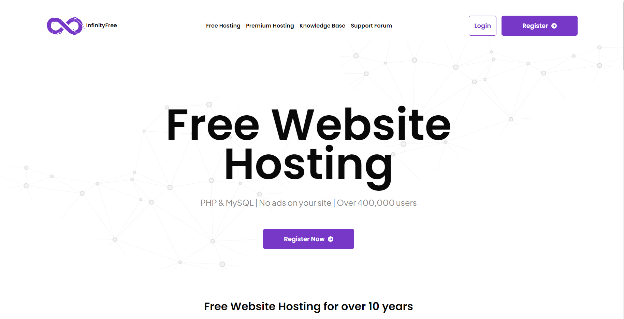
Server Hosting

Slide 6
Our Topic
Features
Interface
Other

Slide 7
Features
User Attractive Interface. Easy to knows design.
All data is safe to use.
Lowest Latency Domain and other servers.
Work 24X7….
With free Customer care service.
And others services .

Slide 8
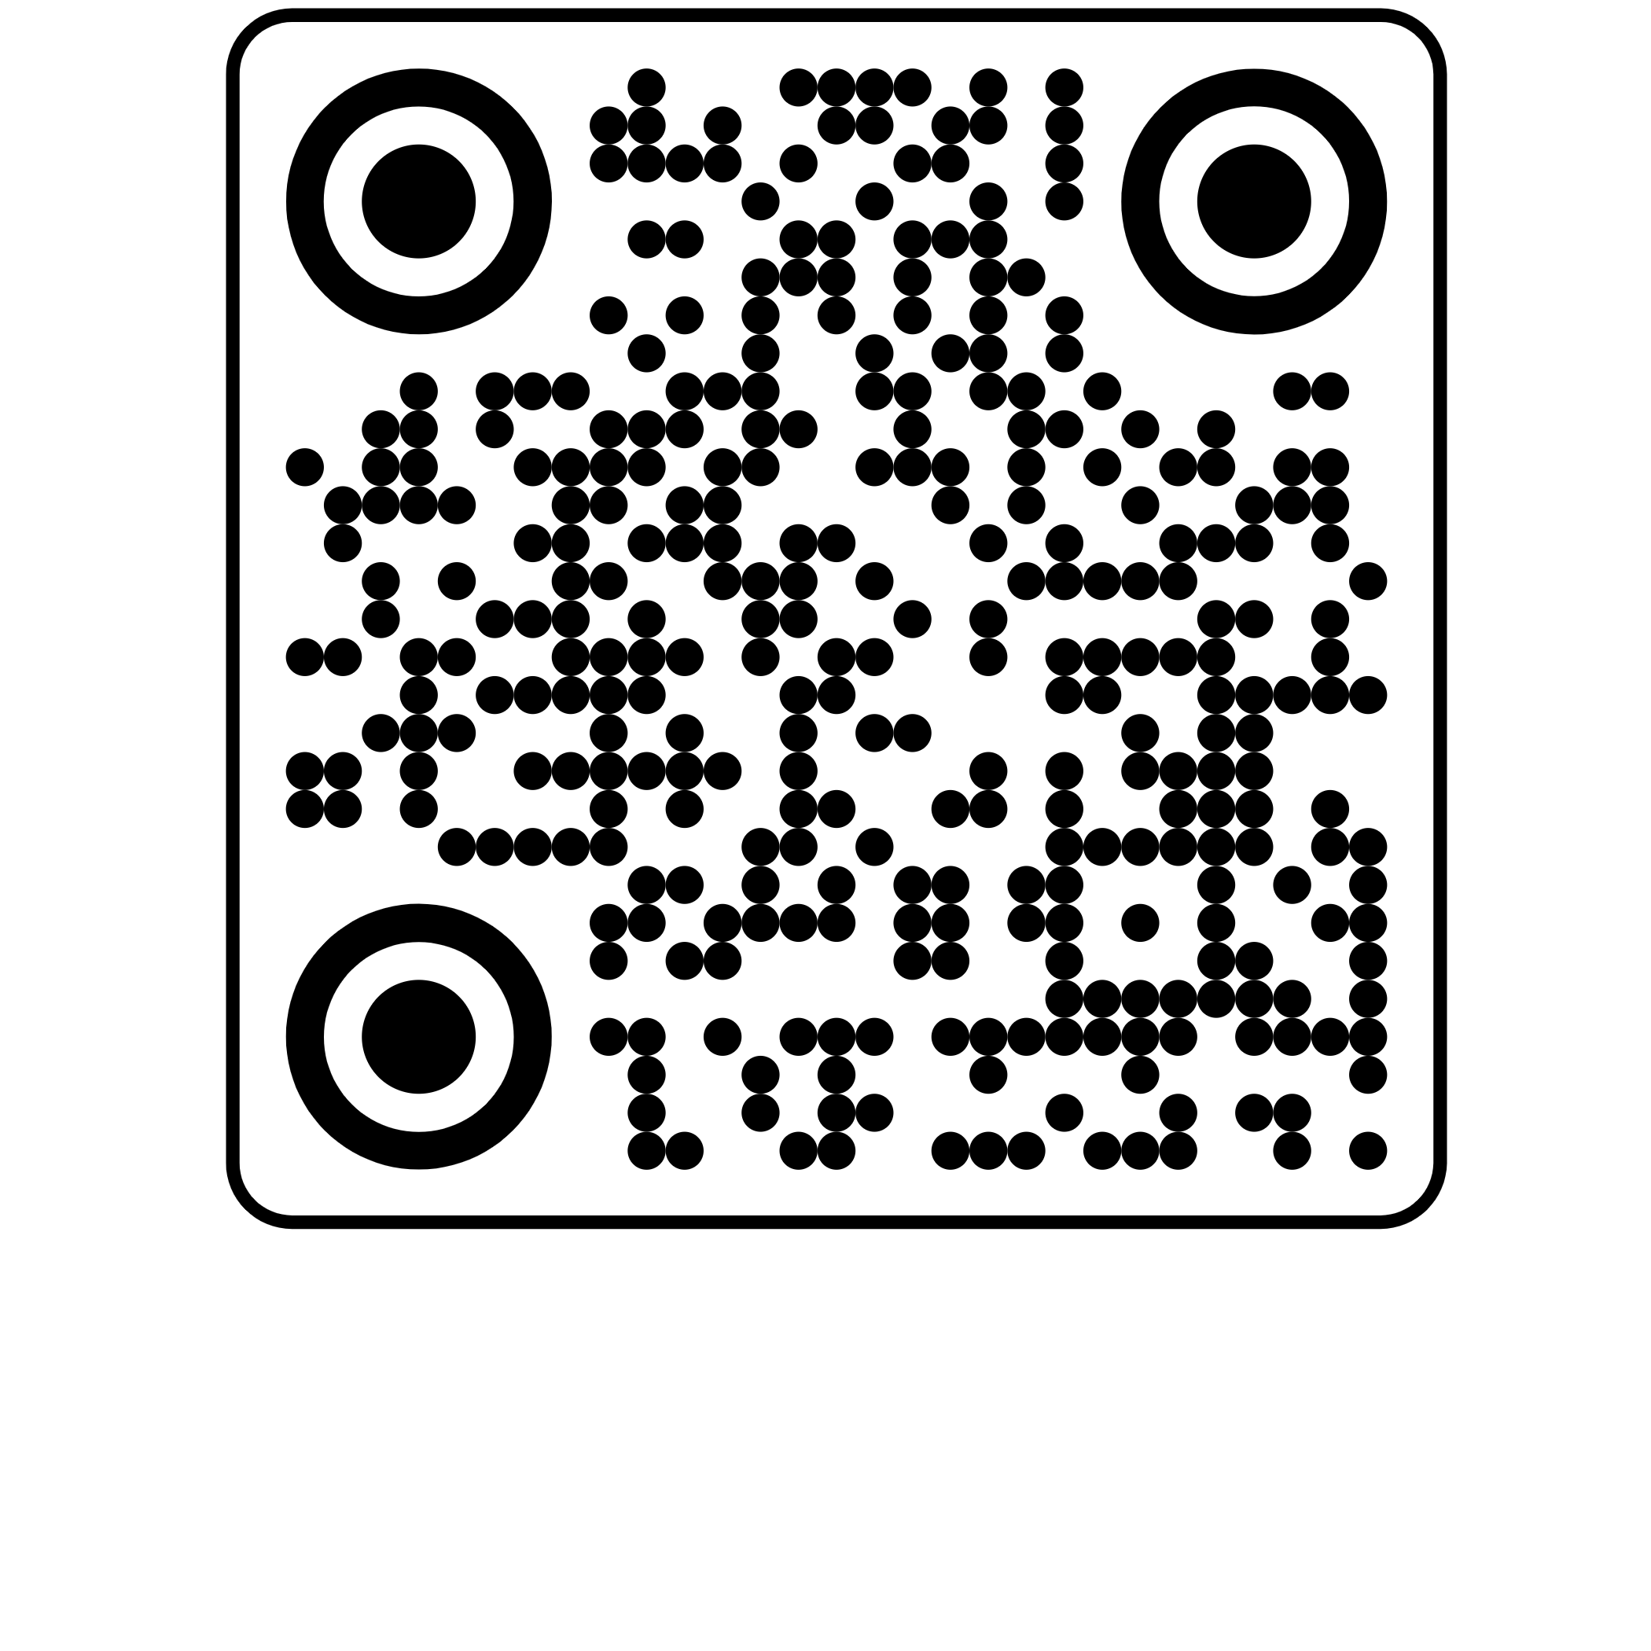
https://ranaghat-ii-iti-govt.epizy.com
Website URL

Slide 9
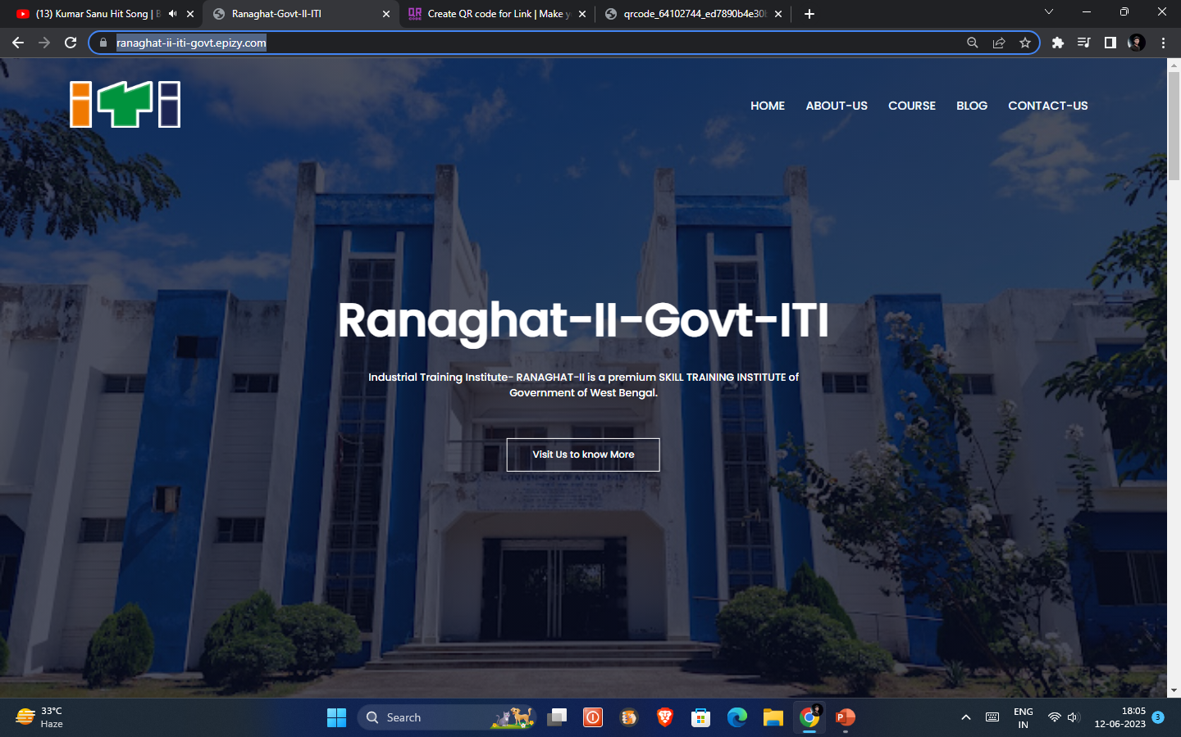
Home Page

Slide 10
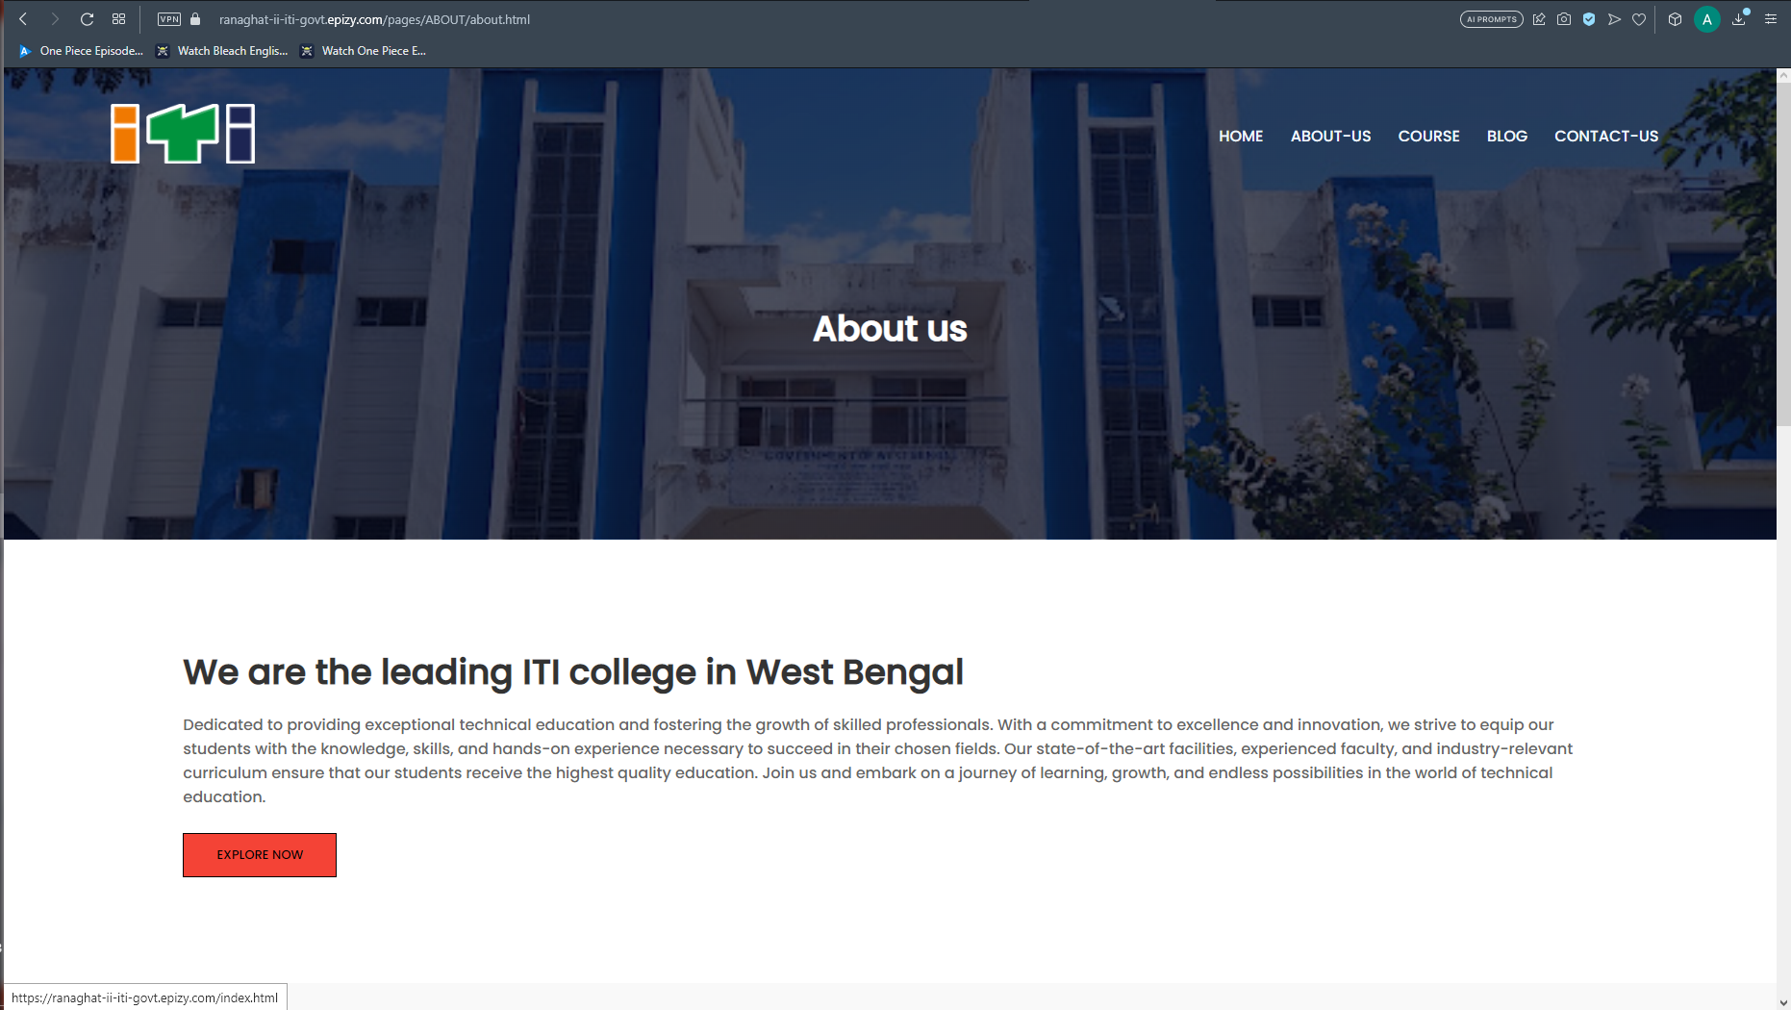
ABOUT-US page

Slide 11
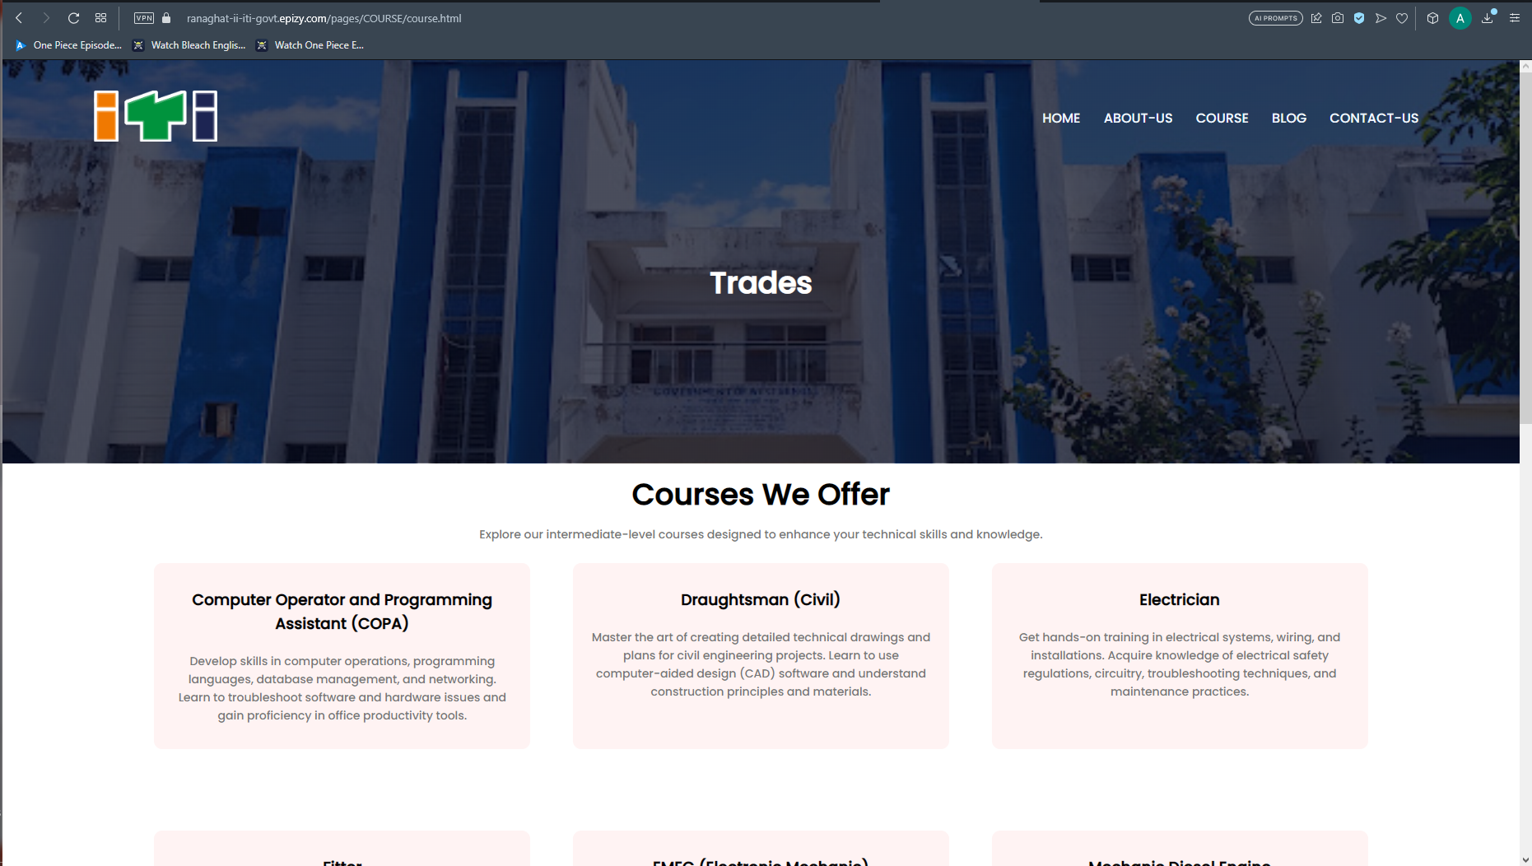
Course page

Slide 12
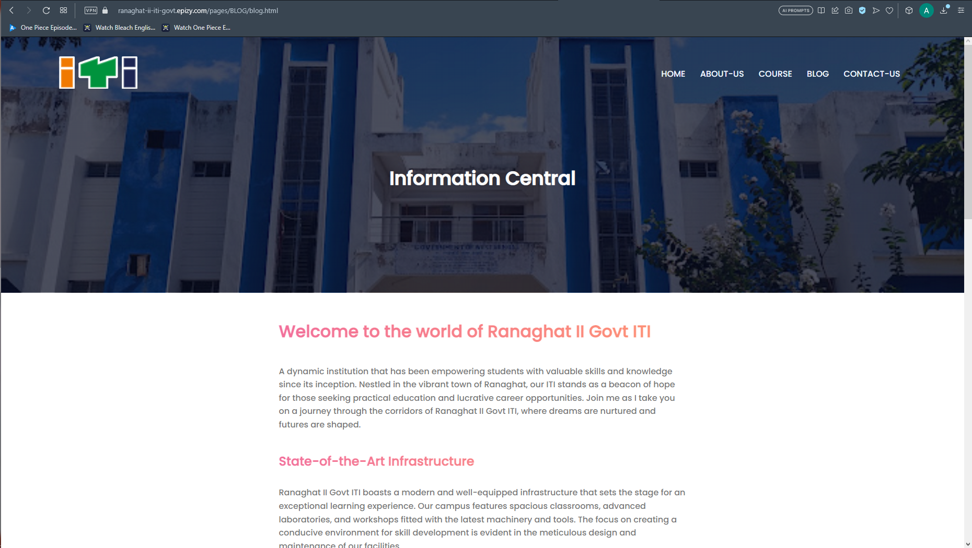
BLOG PAGE

Slide 13
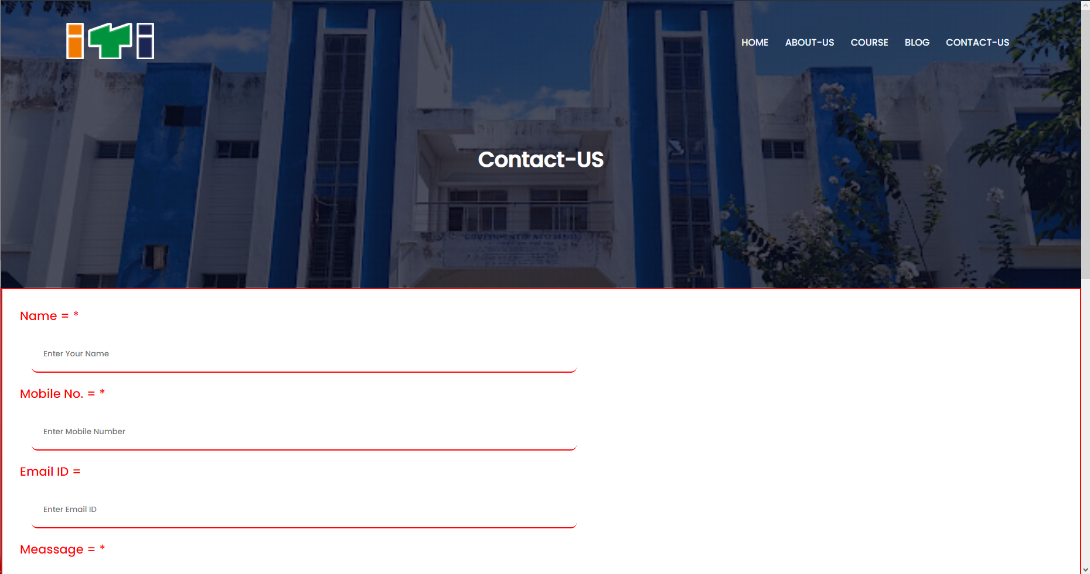
CONTACT-US PAGE

Slide 14
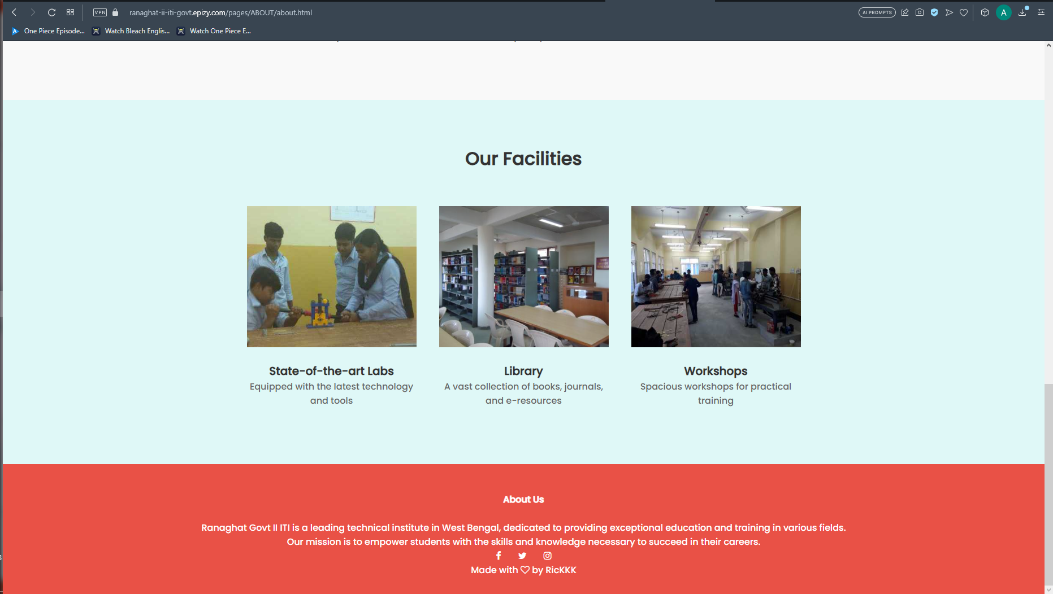
OUR FACILITIES

Slide 15

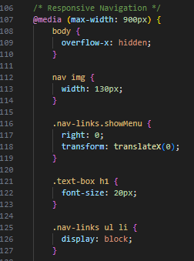
Attractive Navigation Button’s
Pc Navigation
Mobile Navigation
Example of @media for Navigations

Slide 16
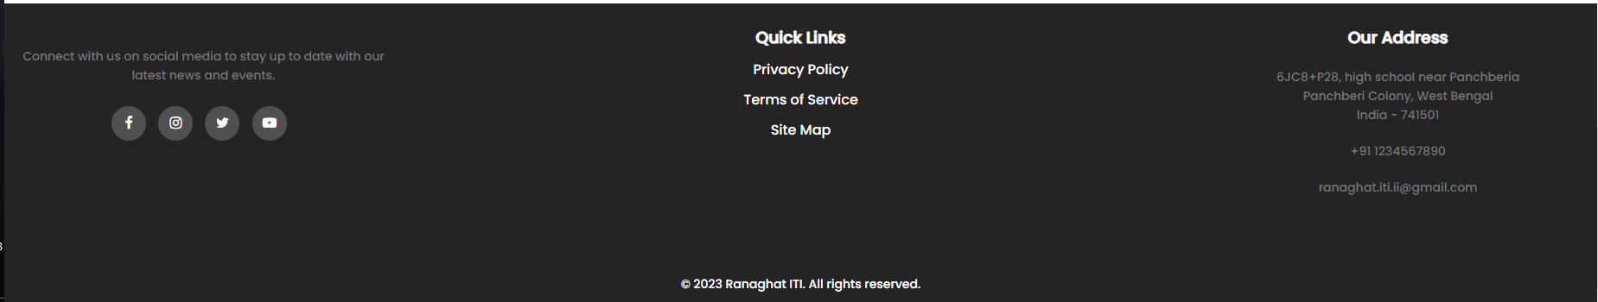
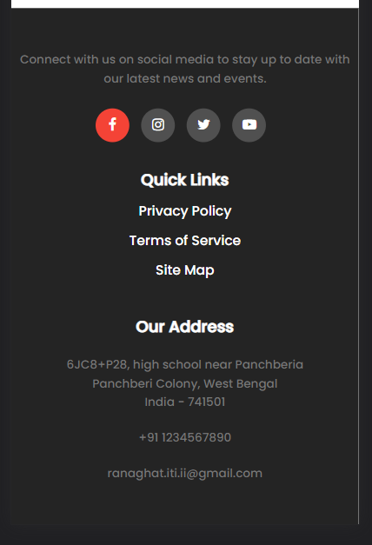

Footer
We also added footer section in every pages
Example Css

Slide 17
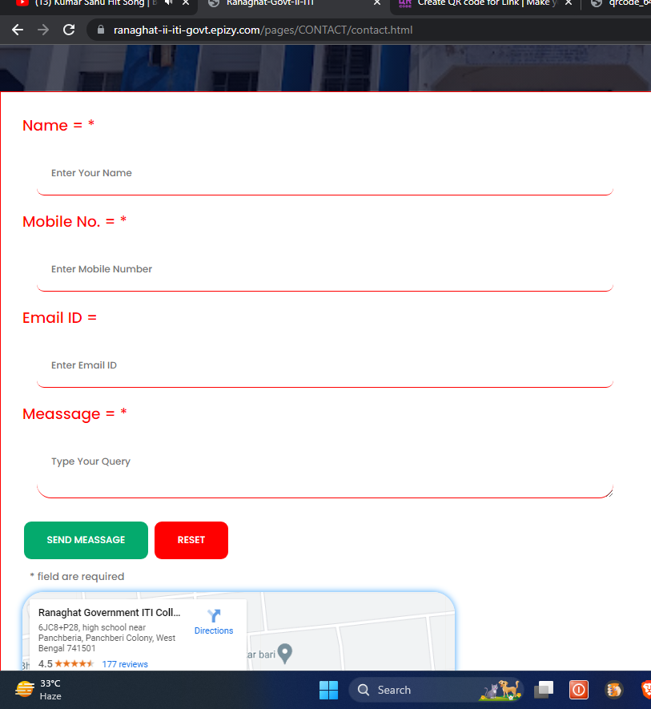
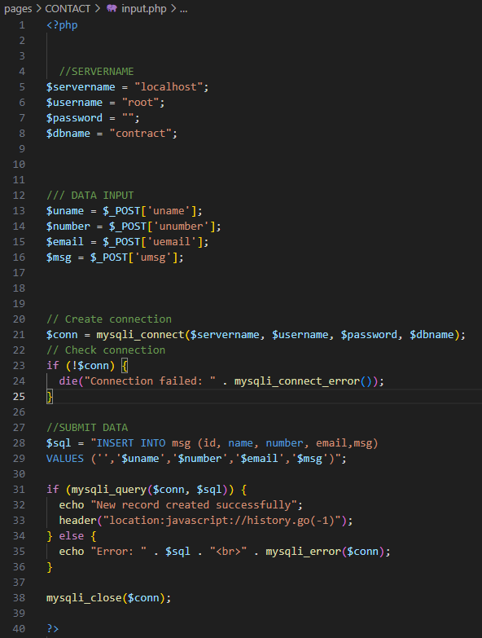
Quick Response ContactUS From
Example PHP

Slide 18

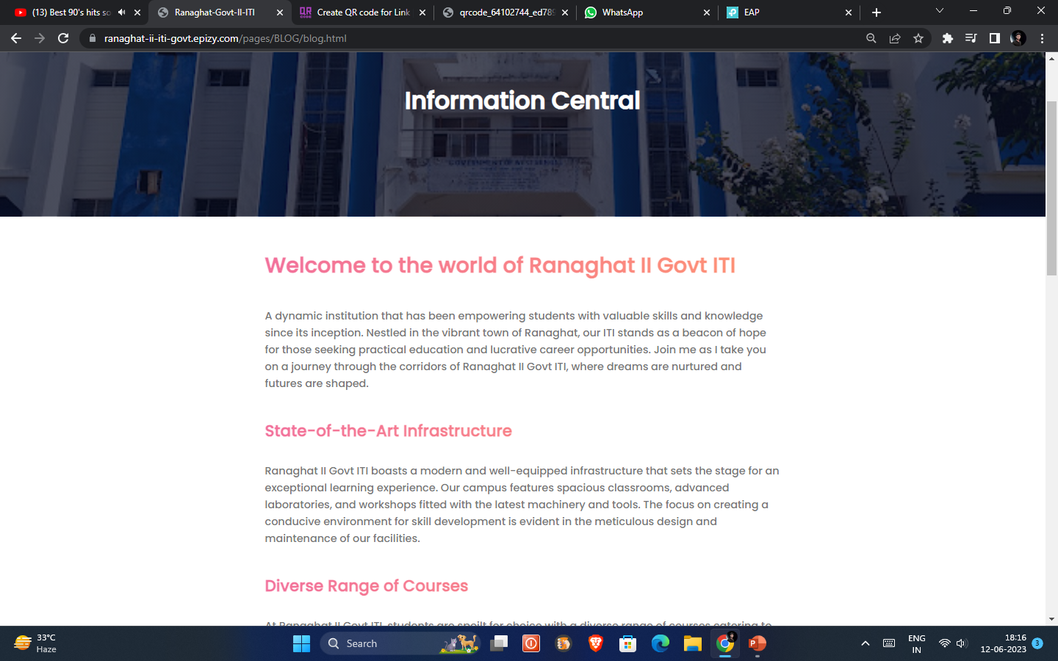
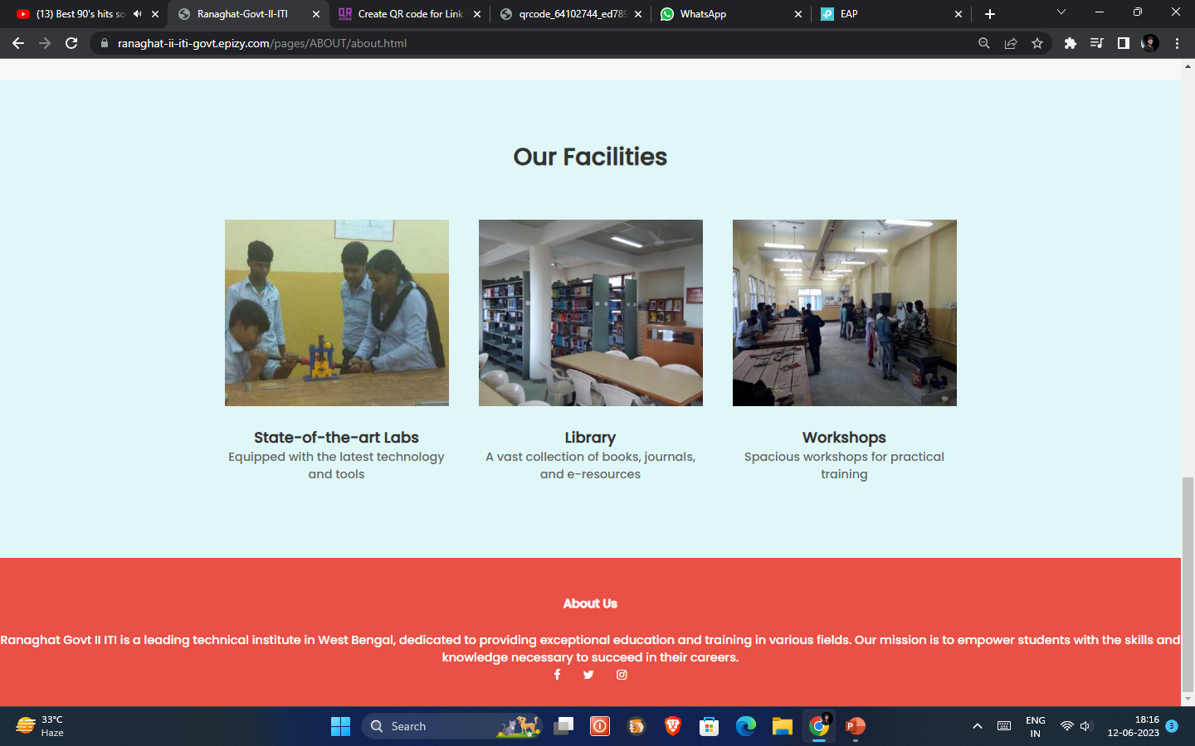
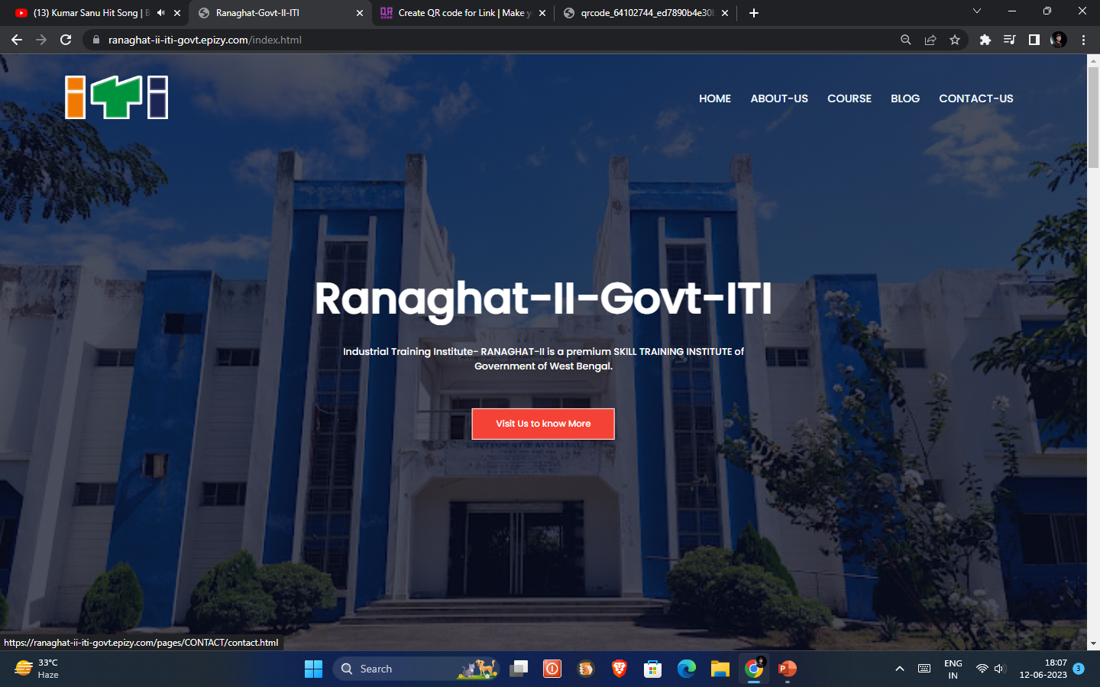
And Other’s

Slide 19



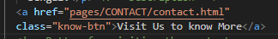
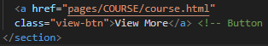
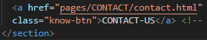
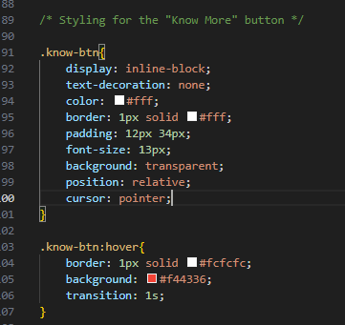
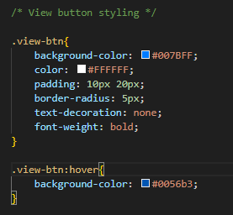
BUTTON Example
HTML
HTML
HTML
CSS
CSS
CSS

Slide 20
SECURITY
Our website prioritizes security by utilizing HTTPS instead of HTTP (SSL Certificate)
HTTP
HTTPS
HTTP is a protocol used for transmitting data over the internet. It operates on top of the TCP/IP protocol and is considered to be insecure because the data transmitted between the client (web browser) and the server is not encrypted. This means that if someone intercepts the communication, they can potentially read or modify the data being transmitted. HTTP is commonly used for regular web pages, where security is not a critical concern.
HTTPS, on the other hand, is a secure version of HTTP. It incorporates the use of SSL (Secure Sockets Layer) or TLS (Transport Layer Security) protocols to encrypt the data transmitted between the client and the server. This encryption ensures that the information exchanged remains confidential and cannot be easily intercepted or tampered with. HTTPS is commonly used for websites that handle sensitive data such as personal information, login credentials, or financial transactions.

Slide 21
contact US
Call -
Email ID –
Website -
+91 1234 1234 12
Ranaghat.iti.ii@gmail.com
ranaghat-ii-iti-govt.epizy.com

Slide 22
Thank You ☺
Please Visit Our Official Website - ranaghat-ii-iti-govt.epizy.com

